Slide 1
Lessons in Debugging Serverless Architecture
Chen Harel

Slide 2
About Me
OverOps: VP Product & Co-founder
Autodesk: Backend team lead
Amdocs: Software engineer
IDF: Software engineer
Coding for fun since 1998 and for $$ since 2003

Slide 3
Agenda
What the FaaS is all about
Debugging capabilities
Getting creative

Slide 4
But first, survey
Notes:
Most production is Serverless
Lambdas are in the critical path
Any Lambdas
How still uses an IDE

Slide 5
Function as a Service
Micro-services, Serverless & FaaS architectures
open up a whole world of opportunity for app development.
It’s easy of use, easy to deploy and easy to operate at scale.
But with that comes loss of control over the JVM
and lessened run-time introspection capabilities.

Slide 6
Debugging Capabilities

Slide 7
Traditional Debugging | Serverless Debugging
Global Exception Handlers | Logs
jstack | Metrics
Java Agent / VM API | Tracing
BTrace | Environmental
JVM TI | Creative
Serviceability Agent API
Remote Debugger

Slide 8
Global Exception Handler

Slide 9
Global Exception Handler
Your last line of defense - critical to pick up on unhandled exceptions.
Setting the callback:
This is where thread Name + TLS are critical as the only surviving state.
Thread.setDefaultUncaughtExceptionHandler((t, e) -> {
logger.error("Uncaught error in thread " + t, e);
});

Slide 10
Preemptive jstack
A production debugging foundation.
Presents two issues –
Activated only in retrospect.
No state: does not provide any variable state.
Let’s see how we can overcome these with preemptive jstacks.

Slide 11
Stateful Thread Names
Thread name is a mutable property.
Can be set to hold transaction specific state in tandem with jstack.
Can be “automated” at code entry point:
Thread.currentThread().setName(context, id, params, timestamp)
"pool-1-thread-25 MsgID: AB5CAD, type: Analyze, queue: ACTIVE_PROD, TID: 5678956, TS: 11/8/2014 18:34 "
#17 prio=5 os_prio=31 tid=0x00007f9d620c9800 nid=0x6d03 in Object.wait() [0x000000013ebcc000]

Slide 12
Threads with Context
Every code layer can push more state onto the thread name.
Will appear in a log file [%thread] and jstack
public static boolean push(String context) {
String curThreadName = Thread.currentThread().getName();
String newThreadName = appendContextToThreadName(curThreadName, context);
getThreadNameStack().push(curThreadName);
Thread.currentThread().setName(newThreadName);
return true;
}
https://git.io/fjg4Y

Slide 14
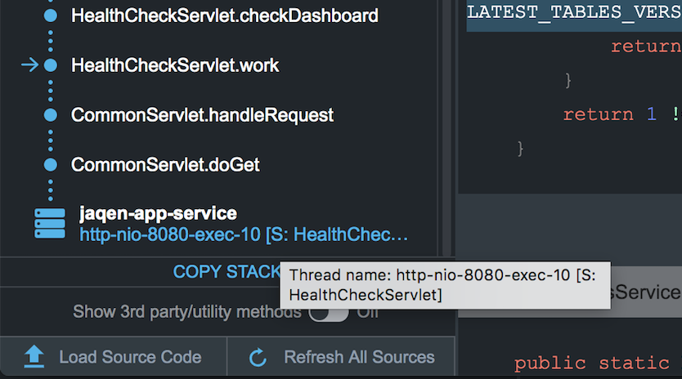
https://demo.overops.com

Slide 15
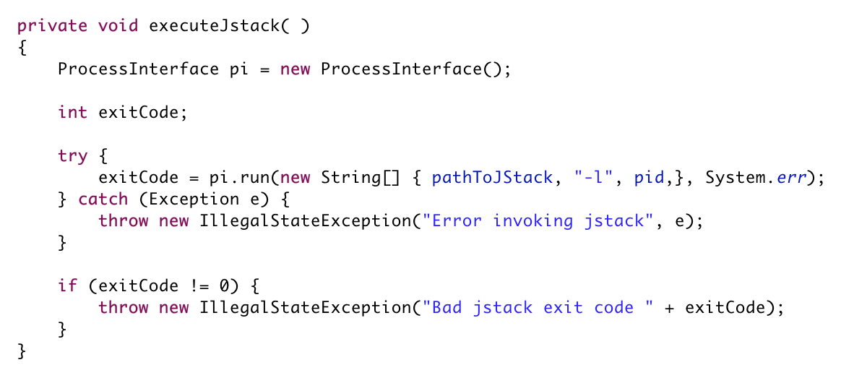
Execute jstack
-l for long listing. https://bit.ly/2ZocuEz
github.com/takipi/jstack

Slide 16
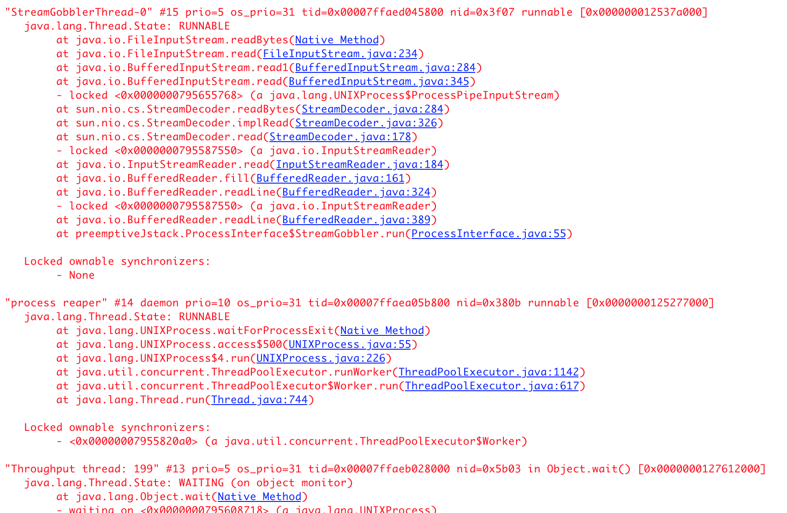
Execute jstack

Slide 17
Agents
An advanced technique for instrumenting code dynamically.
The foundation for most profiling / debugging tools.
Two types of agents: Java-based and Native (C/C++).
Pros: extremely powerful technique to collect state from a live app.
Cons: requires knowledge of creating verifiable bytecode.

Slide 18
BTrace
An advanced open-source tool for extracting state from a live JVM.
Uses a Java agent and a meta-scripting language to capture state.
Pros: Lets you probe variable state without modifying / restarting the JVM.
Cons: read-only querying using a custom syntax and libraries.

Slide 19
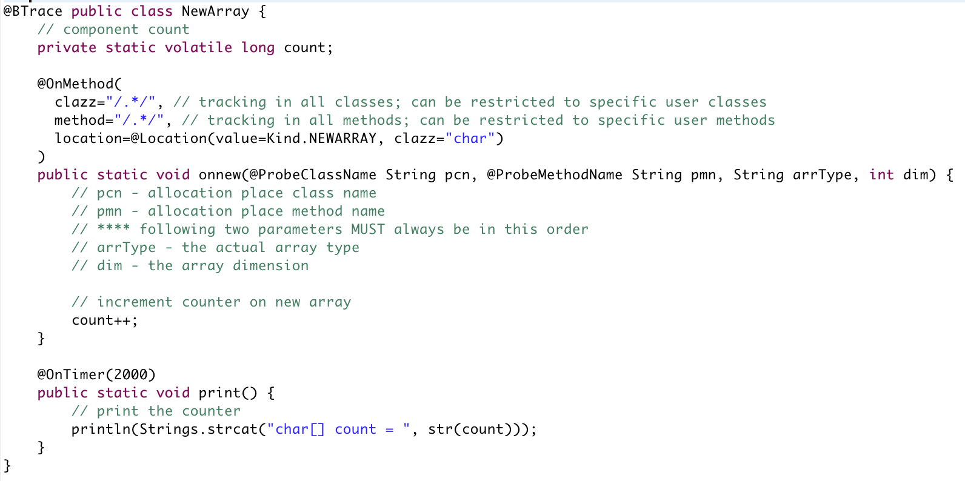
Trace # of char[] Created

Slide 20
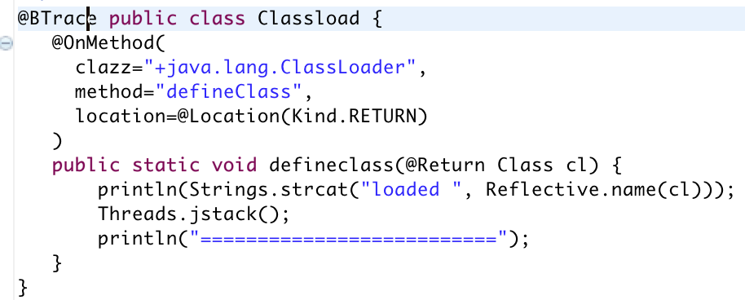
Trace Class Loading

Slide 21
Do-It-Yourself Agent
Endless libraries help produce quality bytecode: ASM, Javassist, ByteBuddy
It all starts with a method
public static void premain(String agentArgs, Instrumentation inst); public static void agentmain(String agentArgs, Instrumentation inst);
And a META-INF/MANIFEST.MF param:
Premain-Class: AgentPreMainClass
Agent-Class: AgentClass
Let’s take a look at a memory leak prevention simple agent

Slide 22
Instrumentation API
getAllLoadedClasses() redefineClasses(ClassDefinition... definitions) retransformClasses(Class<?>... classes)
addTransformer(ClassFileTransformer transformer)
byte[] ClassFileTransformer.transform(ClassLoader loader, String className, Class<?> classBeingRedefined, ProtectionDomain protectionDomain, byte[] classfileBuffer)
The implementation of this method may transform the supplied class file and return a new replacement class file.
Notes:
Redefinition means that at an arbitrary point of time an agent will invoke Instrumentation. redefineClasses to change the actual definition of existing (and already loaded) classes. The agent will provide the bytecode for the new definition.
Retransformation refers to the process of class file transformation which is normally applied at class loading time. Agents can register ClassFileTransformers which are called one after another to apply transformations to the byte code before the class will be initialized. So Retransformation refers to the capability of the JVM to repeat this process for already loaded classes. In this case an agent may invoke Instrumentation.retransformClasses specifying which classes to retransform but no bytecode. Instead the JVM will call all registered retransforming capable ClassFileTransformers providing the actual bytecode (or the result of the previous transformer for a chained transformer).

Slide 23
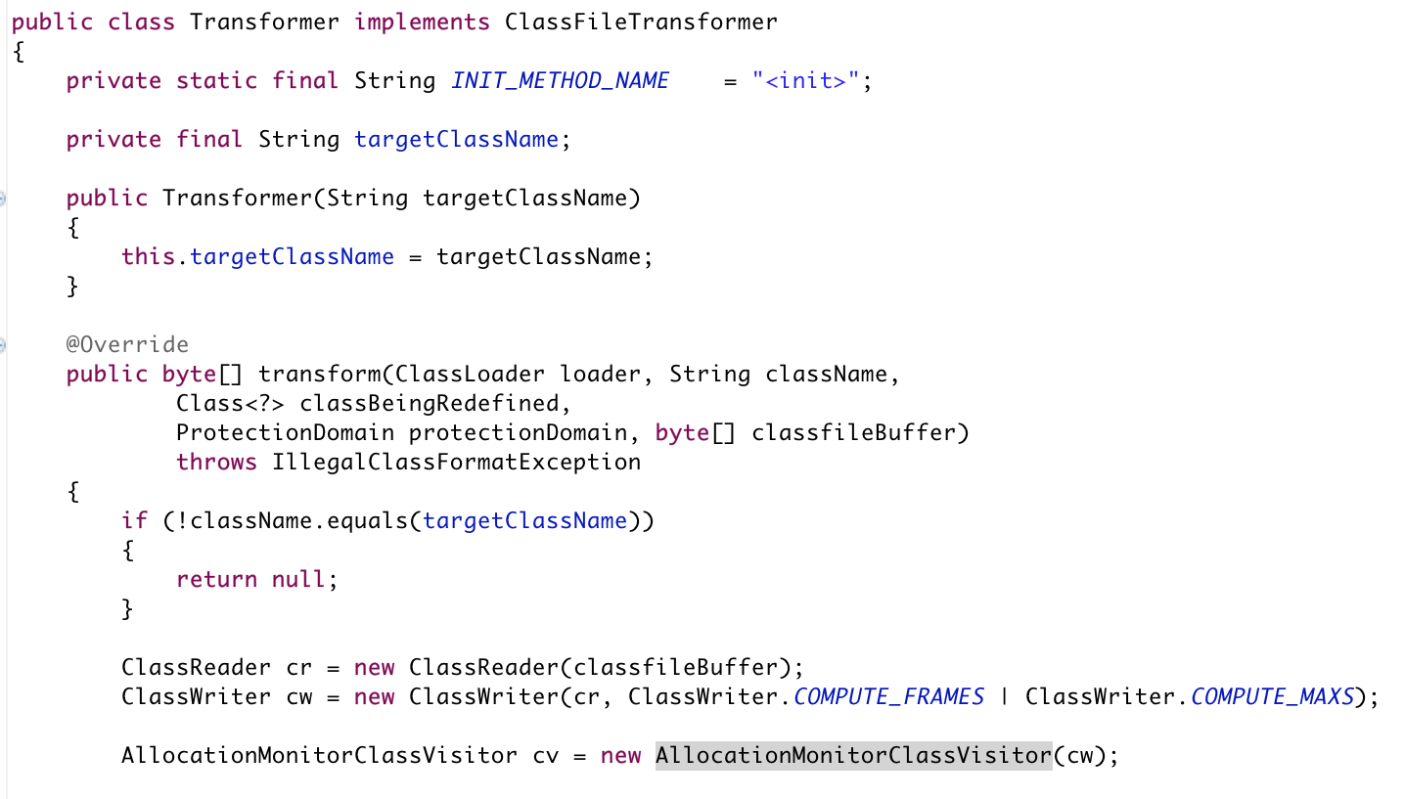

Slide 24
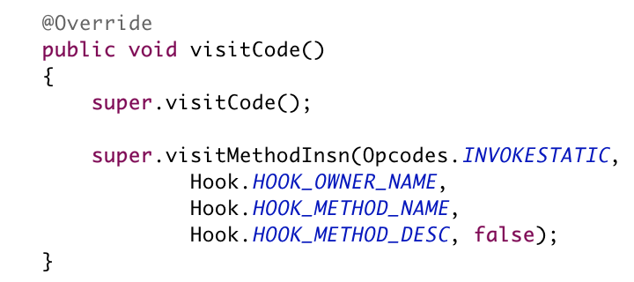
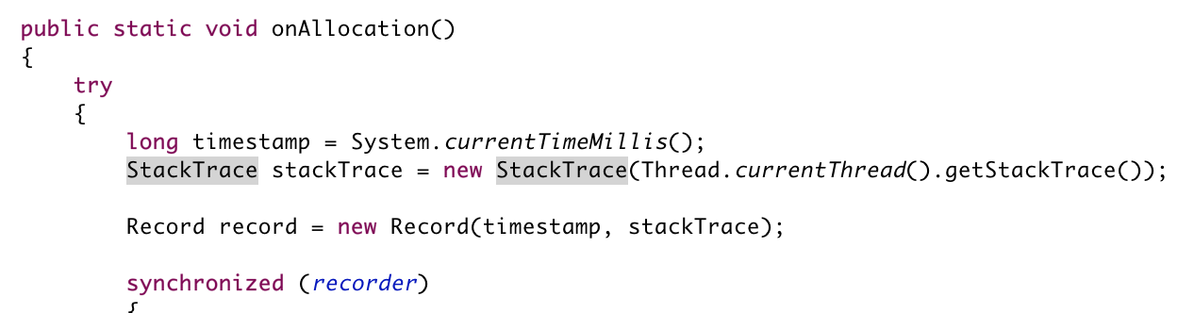

Slide 25
Native Agents (JVM TI)
Java agents are written in Java. Have access to the Instrumentation API.
Native agents – written in C/C++. Have access to JVM TI – the JVM’s low-level set of APIs.
JIT compilation, GC, Monitors, Exceptions, Breakpoints, ..
More complex to write. Can greatly impact performance.
Implementation specific (HotSpot, IBM J9, Azul Zing, ..)

Slide 26
Serviceability Agent API (HSDB)
A powerful backdoor into the Hotspot JVM.
Complete access into discrete internal JVM classes from within the JVM or externally.
Requires intimate understanding of the JVM.
The most powerful way to introspect the state of the JVM.
Can be run externally or from within the JVM (Java 8 and below):
java -cp .:~/jdk1.8.0_161.jdk/Contents/Home/lib/sa-jdi.jar sun.jvm.hotspot.HSDB

Slide 27
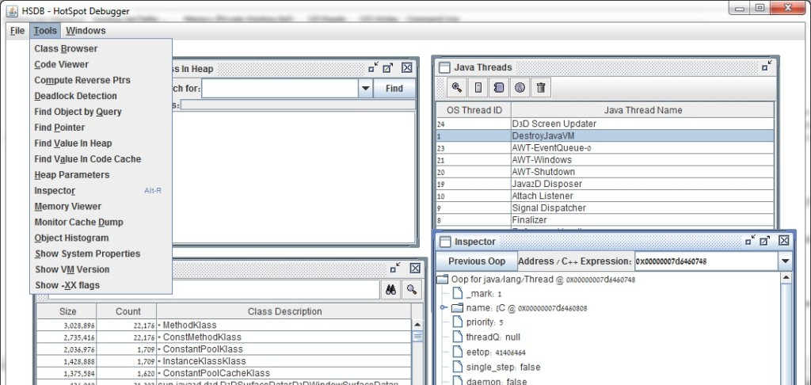

Slide 28
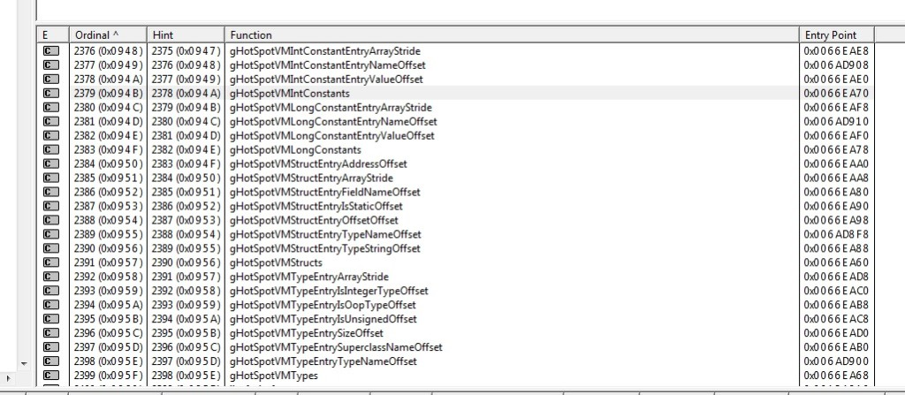

Slide 29
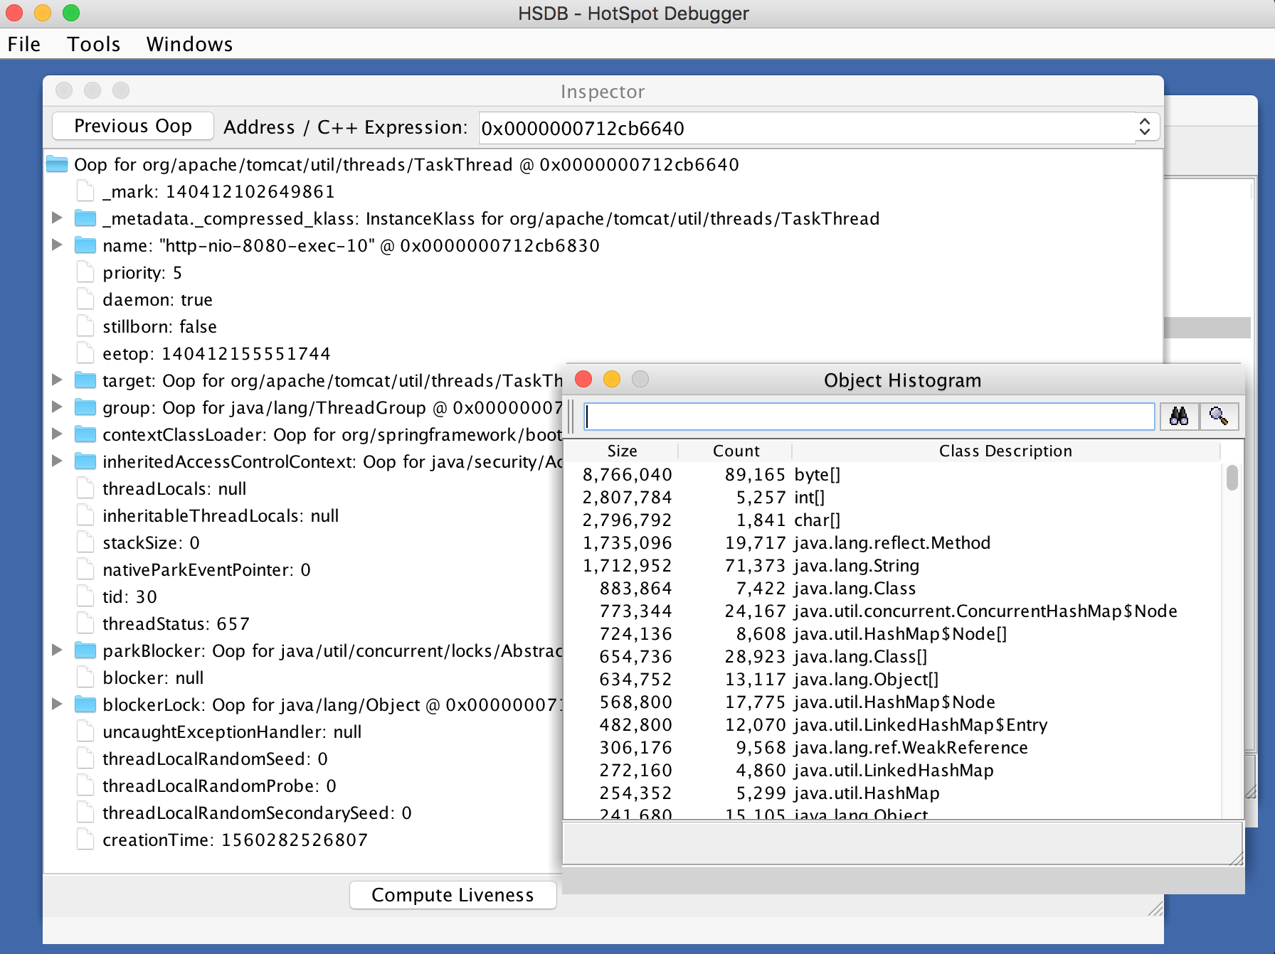
jhsdb
Starting with Java 9,
a new binary: bin/jhsdb is used
GUI
> bin/jhsdb hsdb --pid 42
CLI
> bin/jhsdb clhsdb --pid 42
sa-jdi.jar has been removed.

Slide 30
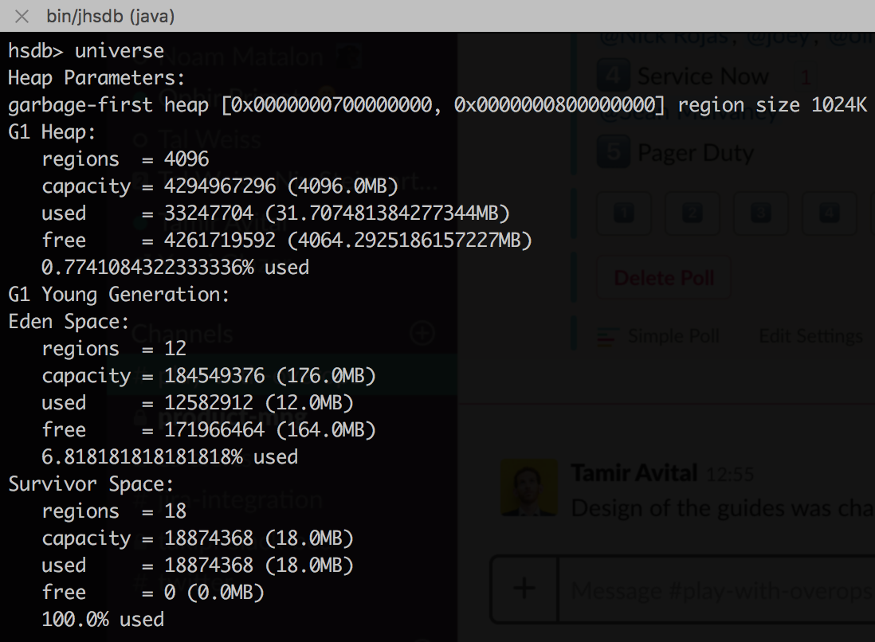
jhsdb
Starting with Java 9,
a new binary: bin/jhsdb is used
GUI
> bin/jhsdb hsdb --pid 42
CLI
> bin/jhsdb clhsdb --pid 42
sa-jdi.jar has been removed.

Slide 31
Remote Debugger
A way to attach an IDE to a remove JVM.
Can halt execution, sometimes changes execution path altogether.
Can be too-powerful as it can change the state in an unrecoverable way.
Source code may not be in sync.
Can be used on a canary server to “feel like home”.
> java -Xdebug -Xrunjdwp:transport=dt_socket,address=8000,server=y,suspend=y -jar app.jar

Slide 32
Traditional Debugging | Serverless Debugging
Global Exception Handlers | Logs
jstack | Metrics
Java Agent / VM API | Tracing
BTrace | Environmental
JVM TI | Creative
Serviceability Agent API
Remote Debugger

Slide 33
Logs
Logging is usually a multi–threaded / process affair.
Make sure to generate, persist and log a unique Transaction ID.
Log your errors, think twice before skipping exceptions.
Log severities – will these DEBUG statements scale?
Pareto principle in logging – remove the waste
Critical for distributed / async debugging.

Slide 34
Metrics
Metrics are time-series data (operational or business) tied to counters and timers.
Metrics are usually visualized in dashboards
If done right (percentiles), can be a great source of health monitoring and alerts
Cons: Hard to get to root cause – data is mostly aggregative in nature

Slide 35
Tracing
Tracing is the de-facto observability technique in Serverless.
A detailed story of a distributed flow with multiple async services involved.
OpenTracing has been adopted by most vendors (New Relic, DataDog, Lightstep) and open-source projects (Jaeger, Zipkin).
Usually requires code annotations, wrappers or filters.
Can be eased with AOP-like approached that auto-inject traces. https://bit.ly/2Kd4QcR

Slide 36
Challenges with Tracing
Need to pass a Trace ID across all services, sometimes 3rd parties which you can not control.
Need a way to store, analyze and visualize.
Need a way to raise/lower the number of transactions traced in real-time.
Many tools are AWS-first (and possibly last).
How to debug the code?

Slide 37
Environmental
Many tools monitor Serverless frameworks from the outside.
They look at the Functions footprint and external resources consumed.
Same challenges as with tracing.
If it is still unclear what are we talking about:
AWS X-Ray, Google Stackdriver, Lumigo, Epsagon, IOpipe and more.

Slide 38
Tracing and environmental monitoring are very powerful
but
we want to debug

Slide 39
Getting Creative
We wish to bring back ancient techniques to the modern world.
- Guardian Angel
- Brute-force agent
- Layered agent

Slide 40
Guardian Angel
A template framework to apply the following techniques within a Function:
- Stateful thread naming
- Global exception handling
- Preemptive jstack
- Timeout and critical failure state capture
Considerations: consistent across distributed flows,
Throttles at scale, minimal code change.

Slide 41
Guardian Angel
A template framework to apply the following techniques within a Function:
- Stateful thread naming
- Global exception handling
- Preemptive jstack
- Timeout and critical failure state capture
Considerations: consistent across distributed flows,
Throttles at scale, minimal code change.

Slide 42
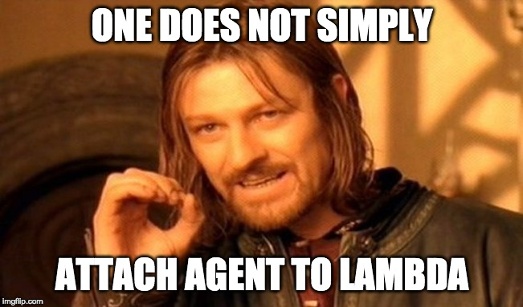
Agents in Lambdas

Slide 43
Agents in Lambdas
In most FaaS the execution runtime is limited (Java 8) but it can be extended.
While AWS Layers were first used to optimize function creation,
it can also be used as a poor man’s instrumentation or even a full blown one.
Running a custom runtime as a function can bring back a lot of technics, including agents.

Slide 44
Brute-force Agent
A template framework to apply the following techniques within a Function:
- Download an agent
- Spin another JVM with the agent

Slide 45
Layered Agent
Using AWS Layers to inject an agent
Wrap the user Lambda with our own
Uses dynamic attach to load agent

Slide 46
Layered Agent
Using AWS Layers to inject an agent
Wrap the user Lambda with our own
Uses dynamic attach to load agent

Slide 47
Layered Agent
Add the AmazonLinux1803 layer (JDK 1.8.0_202)
Add tools.jar
Add an agent that support live attach
Add a wrapper that can attach the agent
Configure the Lambda correctly

Slide 48
Awesome Layers
Out-of-the-box monitoring using AWS Lambda Layers:
https://github.com/mthenw/awesome-layers

Slide 49
Java 11 in Lambda
Custom runtime, based on java11 slim runtime
https://github.com/andthearchitect/aws-lambda-java-runtime

Slide 51
Thank you!

